Slide 1

The pursuit of Happiness
Team SoTech | Project 3 | Phase 3+4+5
Team Members | Chun Yang, Deepa Rama Hegde, Jing Wang, Kshitij Kulkarni, Peipei Han, Sheng Ming,
Si Lu Liu, Snigdha Goel, Vijaya Lakshmi Tulasi Pali, Xueting Yan, Yu Dong

Slide 2
OBJECTIVE & Variables
To analyze the activities that make people happy and check the effect of these factors on how happy you are
Dependent Variable: Happiness Index
Independent variables:
Demographics
Lifestyle
Social Media
Country of origin, Country currently living in, Gender, Age, Zodiac
Profession, Relationship status, Hours of exercise (monthly), Social life
Number of hours spent, Favorite social media platforms, Number of friends on most frequently used social media platform, How often people update social media

Slide 3
Data ANALYSIS AND MODELING
Correlation
Regression
ANOVA
Recommendations
Cluster
RPM
Website

Slide 4
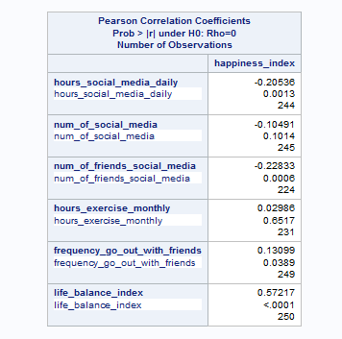
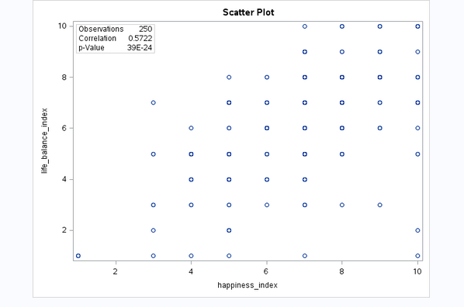
cORRELATION

Slide 5
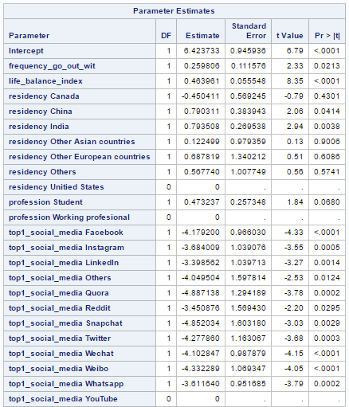
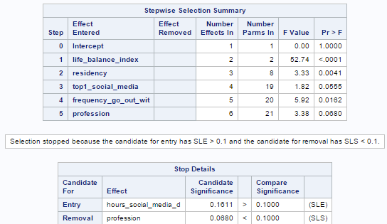
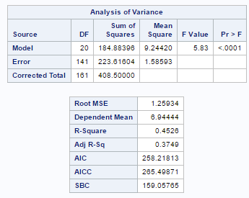
REGRESSION

Slide 6
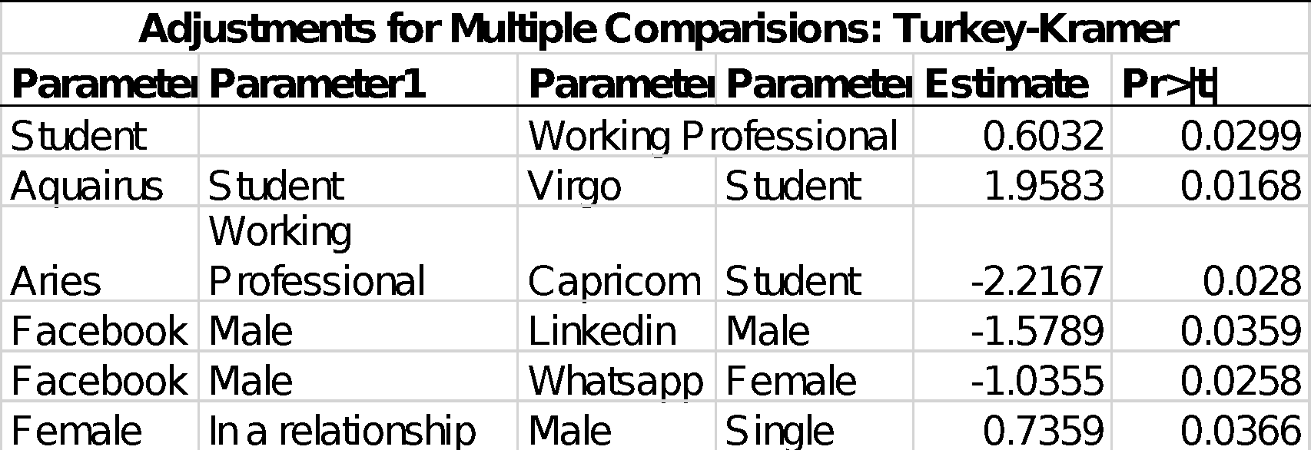




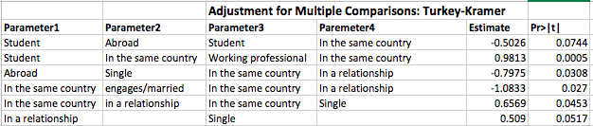


ANOVA

Slide 7
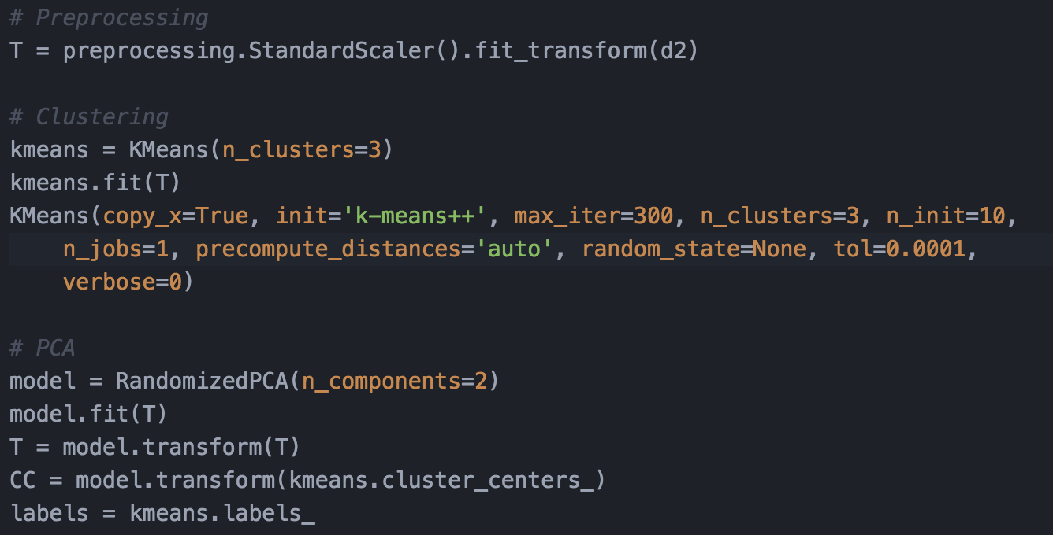
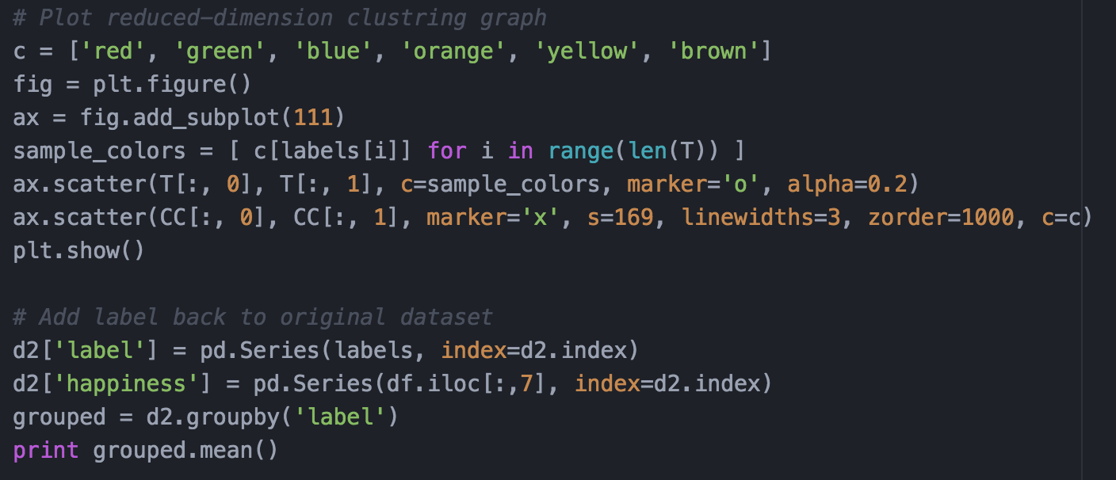
CLUSTER – ALL continuous
Data Manipulation Process:
Preprocessing:
Standardization
Clustering:
K-Means (3 clusters)
PCA:
Reduced to 2 dimensions (easy for plotting)

Slide 8
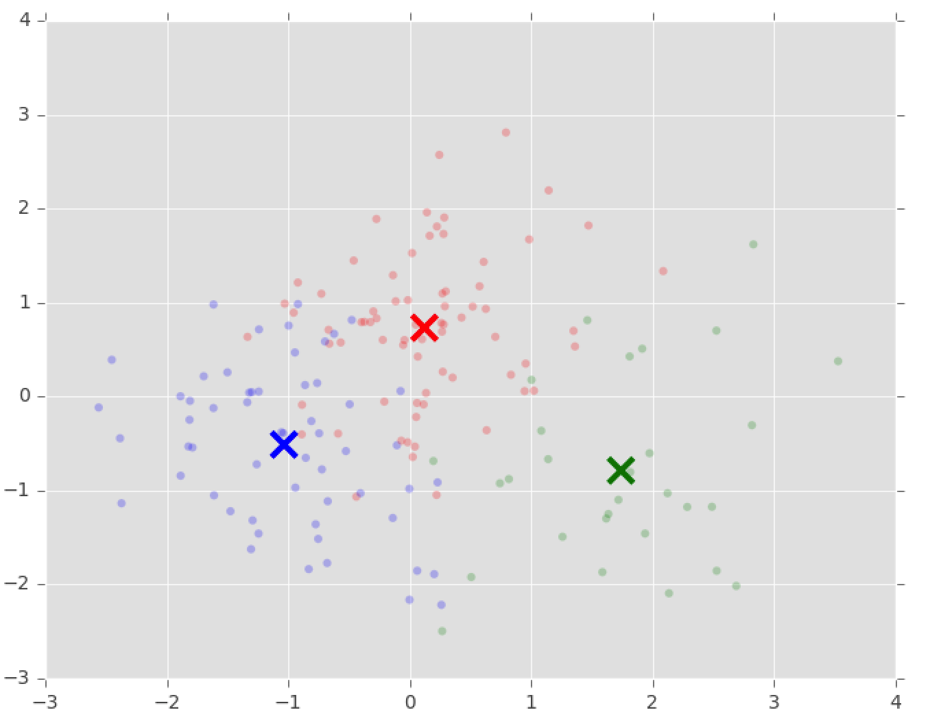
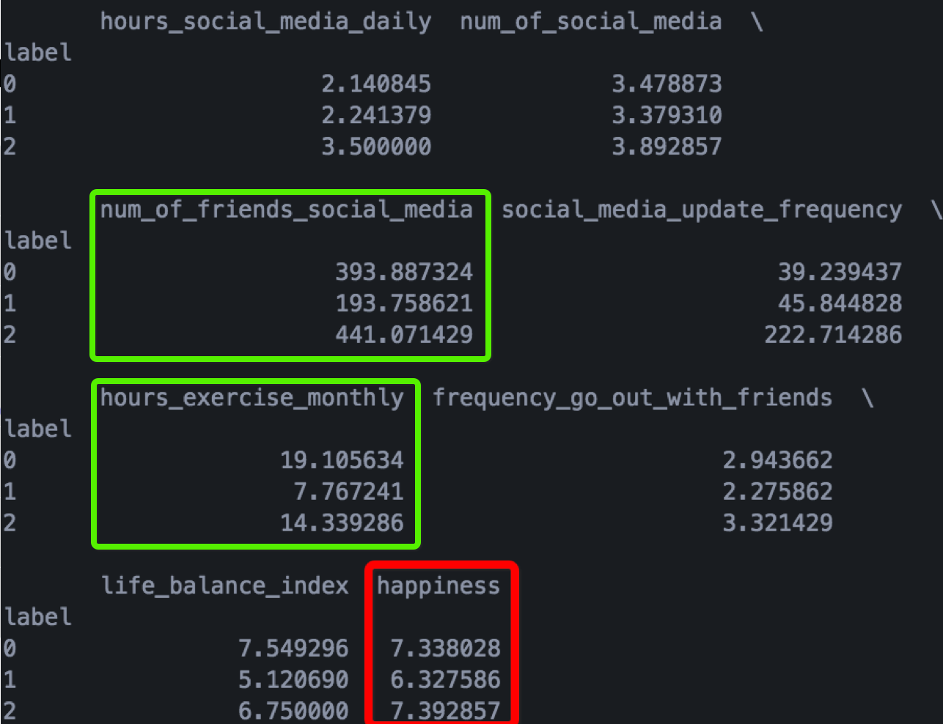
CLUSTER – ALL continuous

Slide 9
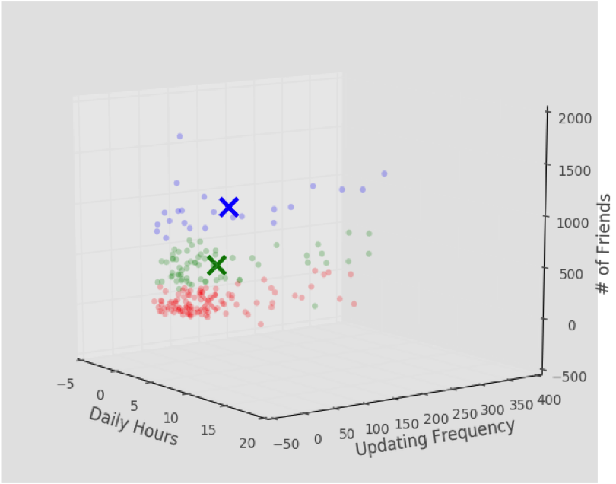
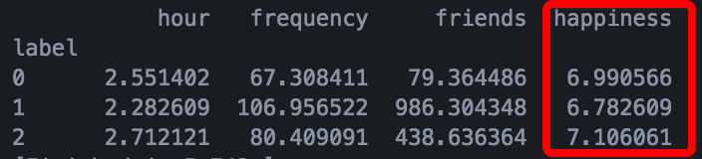
CLUSTER – SOCIAL MEDIA RELATED
CLUSTER – ALL continuous

Slide 10
RPM
Notes:
Index with 5 or greater than 5, it’s considered it as 1 and 0 otherwise
Value 1 is average and above average. It is of 89%. So most of people consider themselves happy.
Life balance and number of friends on social media are the most important, which consistent to phase 3’ results.

Slide 11
RPM
Notes:
KS value in the ROC is high so we can conclude that the model is powerful to predict data.
ROC index are 0.83 and 0.84 for train and validation respectively. This indicates that the RPM models very well.

Slide 12
Our amazing website
http://sotech-happiness.weebly.com/
an art piece from Judy and Lucia

Slide 13
Recommendation
Average number now is 6.91. How can we try to reach 8?
Friends, family, food.
Life balance & frequency to go out with friends
Overall people in a relationship seem the happiest
Notes:
Quora negative.
Males who believe Linkedin as their top 1 social media.
Negative correlation in time spent, friends amount and posts on social media. More attention on social media, less likely to be happy in reality.

Slide 14
Final Recommendation
1. Don’t be alone.
2. Don’t be single.
3. Don’t live abroad.

Slide 15
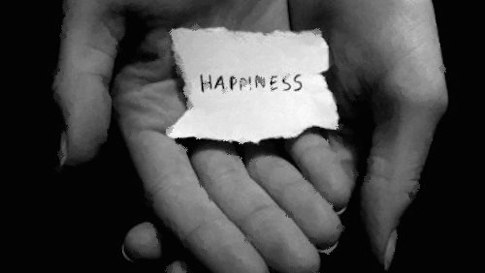
How to find “someone”
1. Meet new people
2. Leave your campus/office
3. Close your laptop
4. Take off your earphones
5. Get a job
6. Smile

Slide 16
How to be happy when single
1. Develop self-awareness
2. Foster other relationships
3. Learn to feel
4. Be weird
5. Invest in yourself and be the person you want to be
Notes:
It says that it takes 10,000 hours to become an expert in something. As such, I should have earned beyond a doctorate degree in the art of being single. Now, while I am far from an expert in anything, there are few things I have earned while being single that it seems majority of people overlook.
where are your dreams, goals, desires, setbacks?
Devoted your undivided attention to your friends and family.
Admit your feelings even when it is sad. Christmas is around the corner.. Is it a hopelessly single night? Do you want to get drunk and cry about it? Do it.
Do something you wouldn’t normally do. Like skydiving, Bungee jumping…what can be worse? You are already single.
Use the time to develop yourself into the type of person you want to be. While you have no attachment, moving to the new city you want to live, get a new job, start a new degree, pick up a language…Love yourself. Because at the end of the day, no one should be responsible for your life, let alone your hapiness.

Slide 17
How to be happy when living abroad
Having a purpose
Explore your new country
Keep Up Your Habits
Notes:
Do a little research about where you're living and find a few places you absolutely have to explore -- the ten best coffee shops in the city, the favorite locations for local street artists or all the different places you can go kayaking. Make a list of these places or activities and challenge yourself to do/see all of them before you leave.
Lots of things change when you move abroad, but everything doesn't have to change. If you were part of an activity, group or team at home, it's understandable that you'll miss that part of your social life - so why not try to find a version of it in your new location?
Maintaining a favorite sport or activity helps bring balance and routine back to your daily life and can make new spaces feel a little more familiar and welcoming. Keeping up with a book club, going rock climbing, attending yoga classes, practicing with a band - if activities like these are an important part of your normal life, don't feel like you have to give them up. There are probably people doing the same activities in your new location - do a little research to find them, and you might even end up making some new friends.

Slide 18
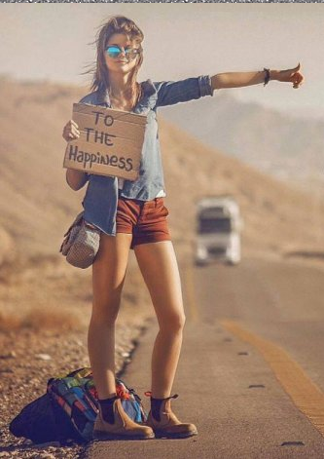

Thank you!

Slide 19
The pursuit of Happiness
Team SoTech | Project 3 | Phase 1+2
Team Members | Chun Yang, Deepa Rama Hegde, Jing Wang, Kshitij Kulkarni, Peipei Han, Sheng Ming,
Si Lu Liu, Snigdha Goel, Vijaya Lakshmi Tulasi Pali, Xueting Yan, Yu Dong

Slide 20

Objective
To analyze the activities that make people happy and check the effect of these factors on how happy you are:
Demographics
Lifestyle
Social media

Slide 21
Variables
Dependent Variable: Happiness Index
Independent variables:
Demographics
Lifestyle
Social Media
Country of origin, Country currently living in, Gender, Age, Zodiac
Profession, Relationship status, Hours of exercise (monthly), Social life
Number of hours spent, Favorite social media platforms, Number of friends on most frequently used social media platform, How often people update social media

Slide 22
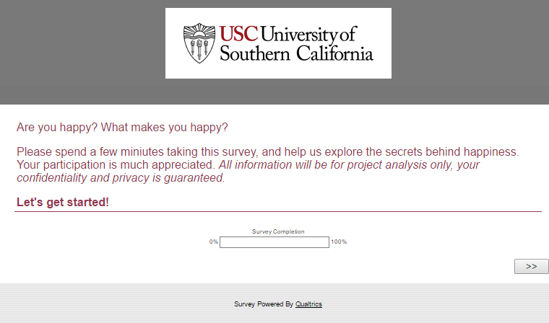
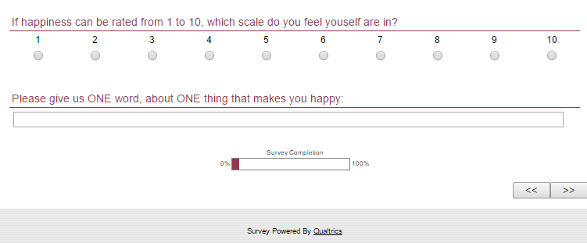
Data Collection and Cleaning
Questions we asked..
Data Collection
Data Processing
Survey via Qualtrics
255 responses collected
If happiness can be rated from 1 to 10, which scale do you feel youself are...
Please give us ONE word, about ONE thing that makes you happy:
Your gender?
Date of Birth– Year/Month/Day
Zodiac based on birthday
Which country/region are you from?
Which country/region are you currently living in?
Are you seeing someone? :P
Currently you are a Student/Working Professional
On average, how many hours do you spend on social media per day?
How many social media platforms do you use?
Top 3 frequently used social media platforms
How many friends/contacts do you have on your most frequently used social media platform?
On average how often do you post an update on your social media account?
How many hours do you go exercise per month?
How often do you go out with friends?
Please rate 1-10 how happy are you with your current work/study-life balance?

Slide 23
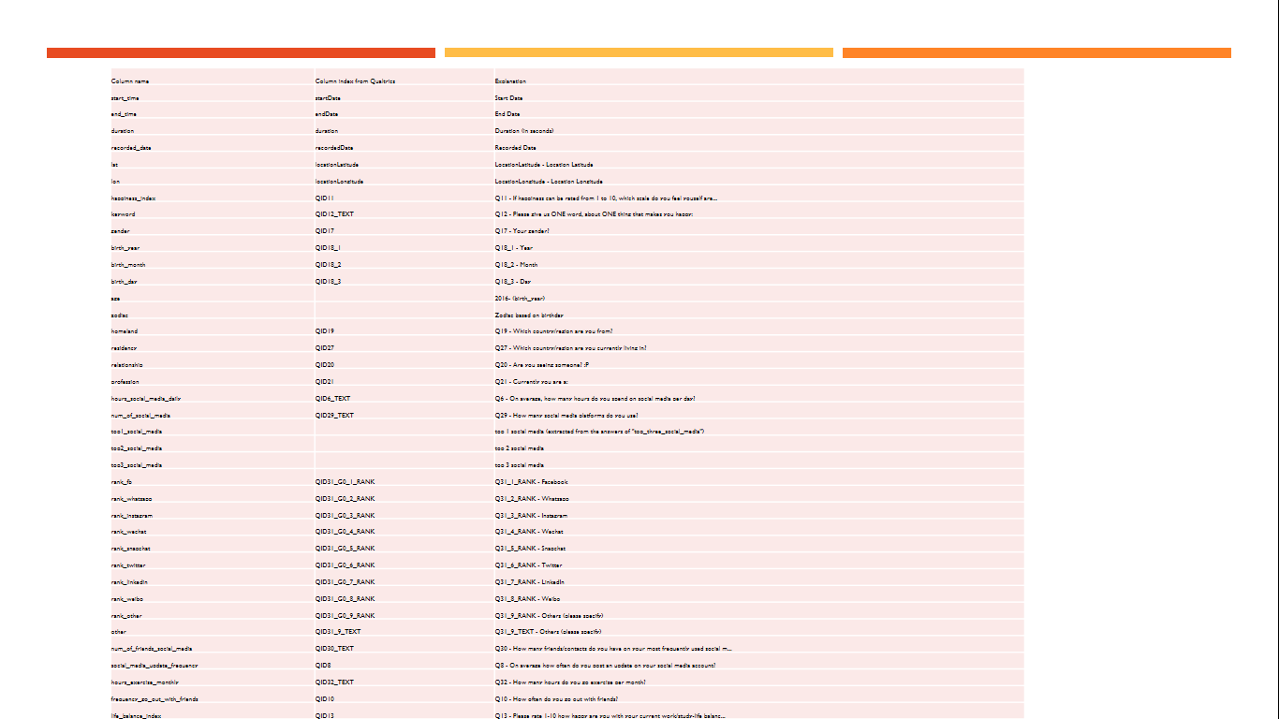
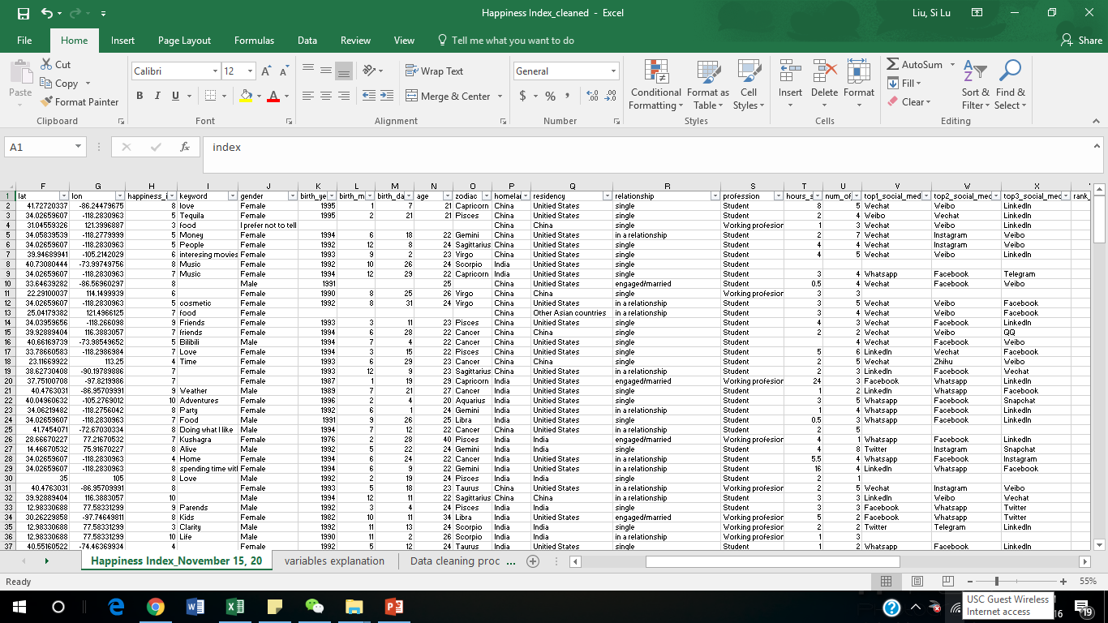
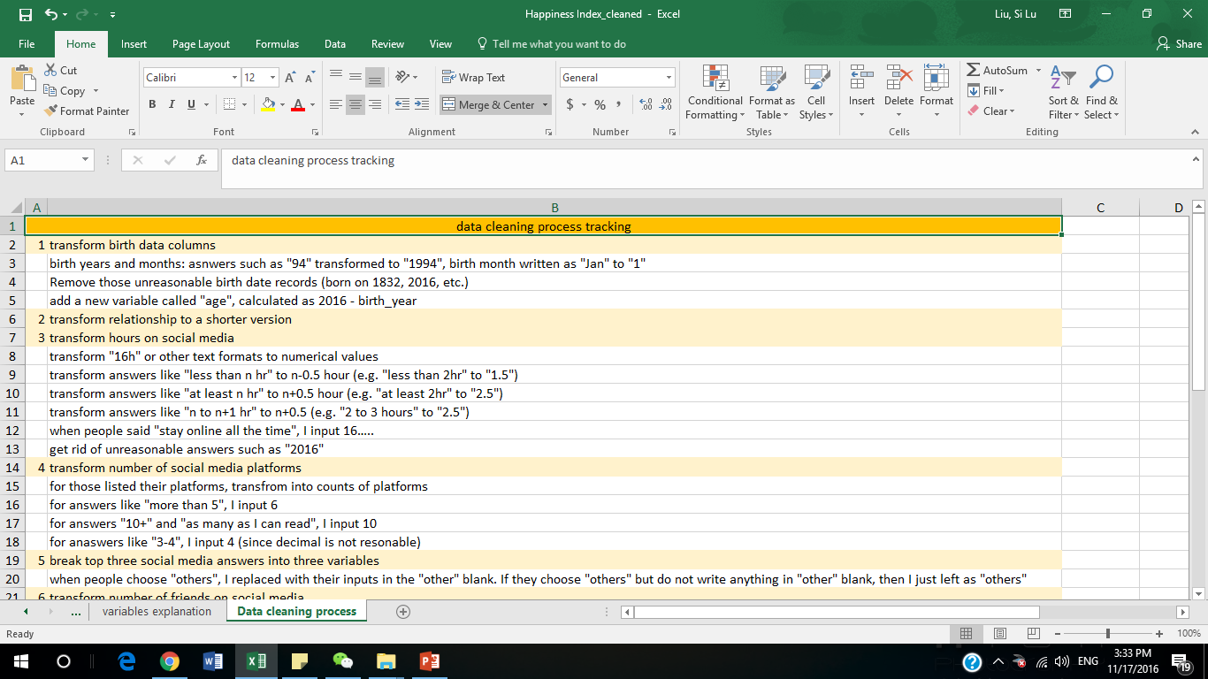
Data Collection and Cleaning
Data Collection
Data Processing
Survey via Qualtrics
Via Excel
255 responses collected
254 observations after cleaning
34 variables

Slide 24

Visualizations
of dependent and independent variables

Slide 25
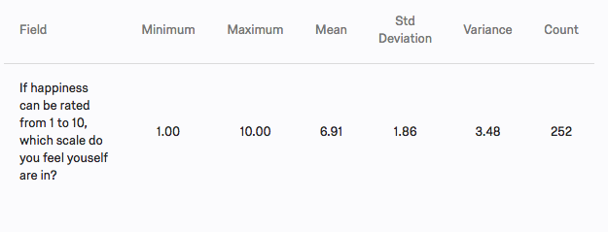
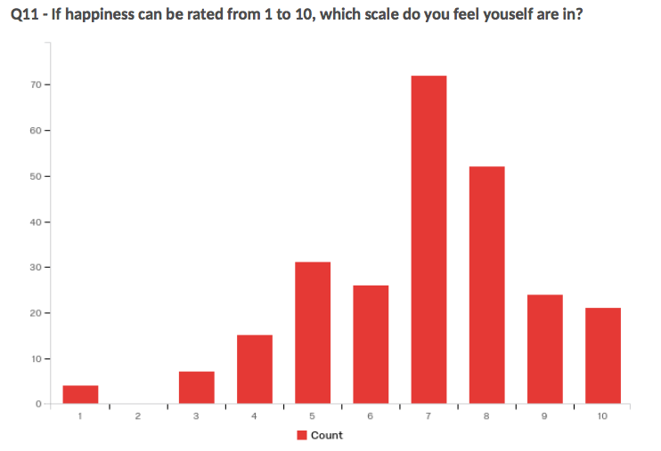
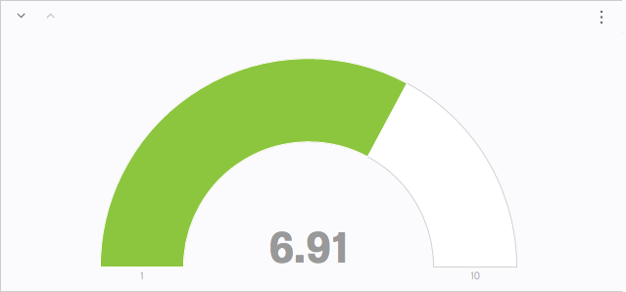
Summary Statistics – Dependent Variable
Happiness Index
Notes:
add sas studio stuff

Slide 26
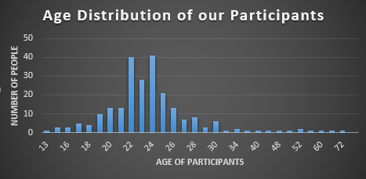
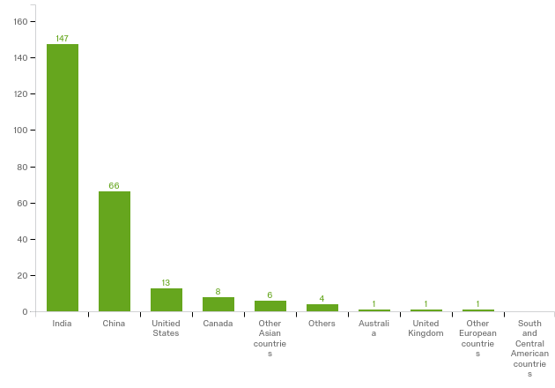
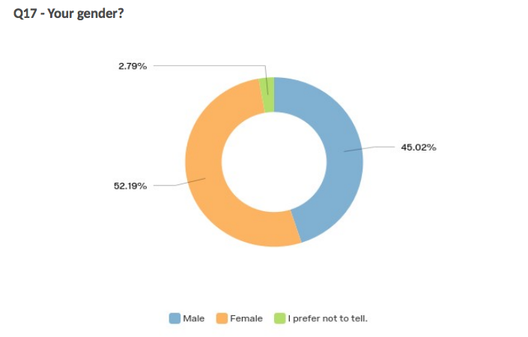
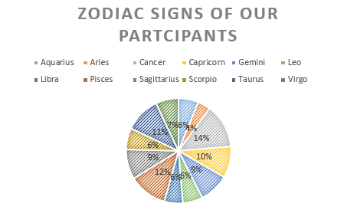
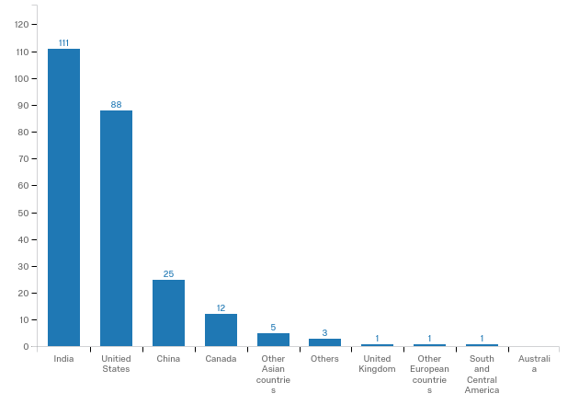
Visualizations – Demographics
Which country are you from
Which country are you currently living in
Notes:
Add Zodiac, age

Slide 27
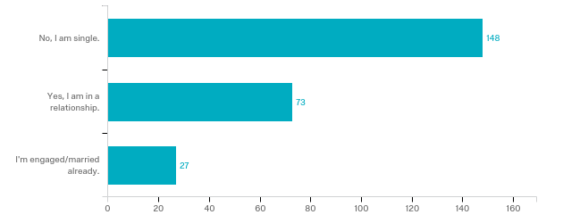
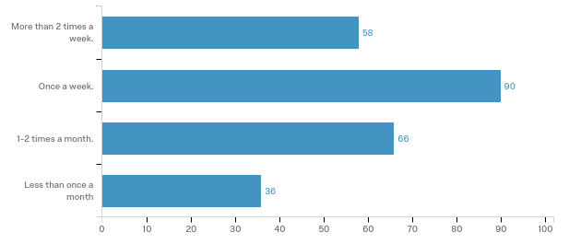
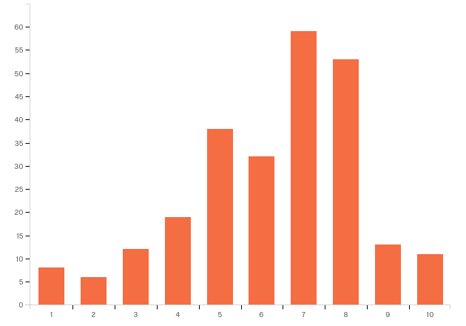
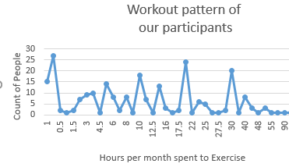
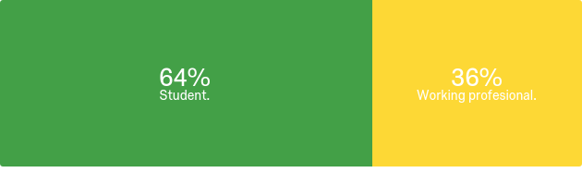
Visualizations – Lifestyle
Relationship Status
How often do you go out with friends
Students/Working Professionals
Rate your work/study-life balance

Slide 28
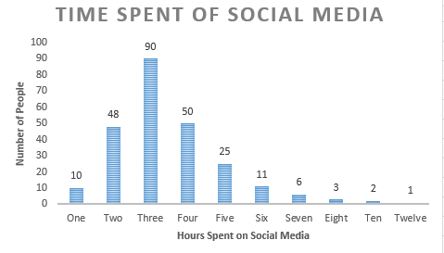
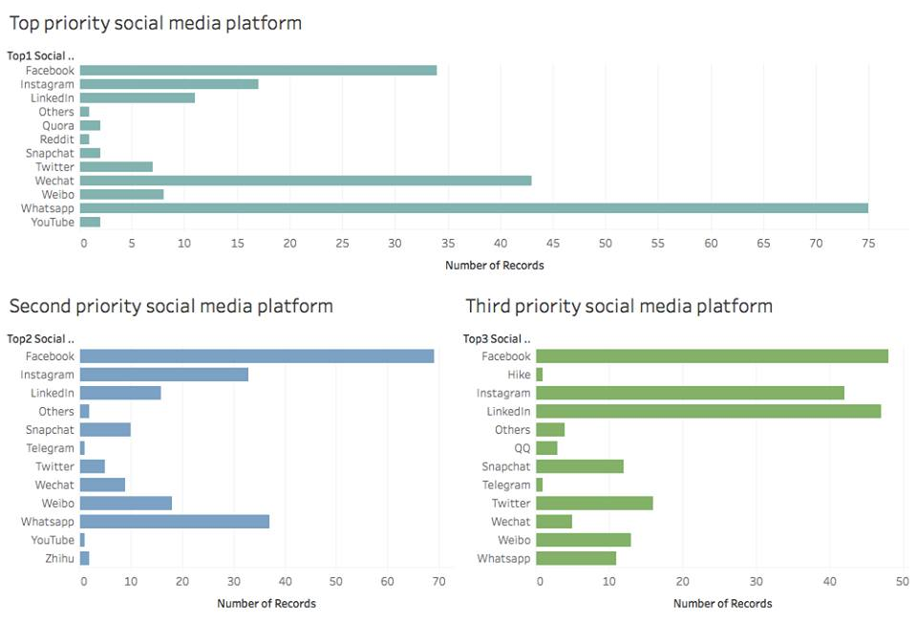
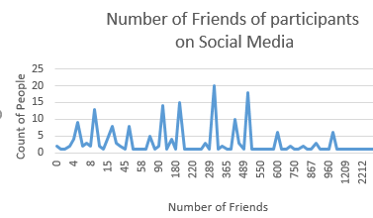
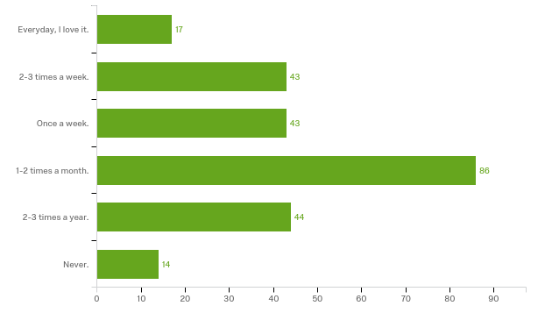
Visualizations – Social Media
How often do our users update on social media
Notes:
fav social media platforms

Slide 29
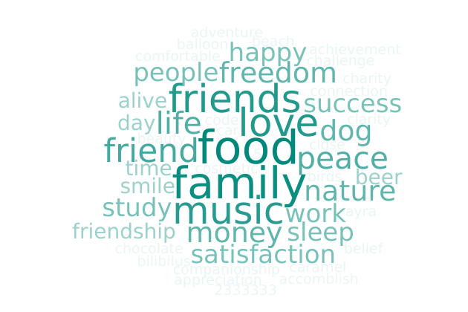
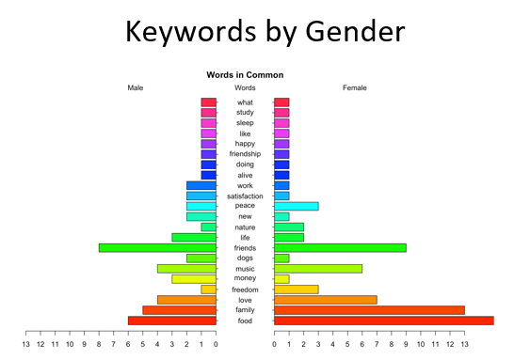
Data Cloud – Key to Happiness

Slide 30
Next Steps
Visualization on combined variables
Correlations
Regressions
ANOVA
Recommendations

Slide 31

THANK YOU! ..QUESTION..?

